Slide 1
M12P Ch6 Trigonometry Review

Slide 2



Slide 3

With a horizontal compression by a factor of 0.5 the graph is compressed horizontally. So the period is 180degrees.
To find the other sets of answrs, addd the period:

Slide 4

There are 3 options for cos2x, pick the one that creates a quadratic equation:

Slide 5

Use the sum and difference identities:

Slide 6
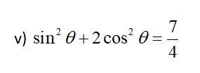
From the Pythagorean identity we have:

Slide 7


Slide 8


Slide 9


Slide 11

First look at all the identities that could be useful:
NOW LOOK FOR RESTRICTIONS!!!

Slide 12
Whenever you see a binomial in the denominator, that’s a sign that you will need to “RATIONALIZE” it by multiplying it with it’s conjugate!!!

Slide 13
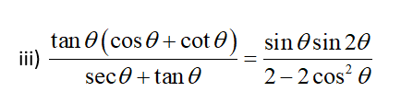
Both sides looks ugly…. It a toss up….
Let’s try the left side first….. So change all the terms to sine or cosine….
RESTRICTIONS:
Well, whadda you know…. They both simplify the cos(x)
NOW this is what the LEFT side simplifies to…..

Slide 14
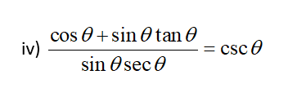
This one is obviously the left side….
RESTRICTIONS….. Remember, when looking for NPVs or restrictions, look at all the denominators…..

Slide 15
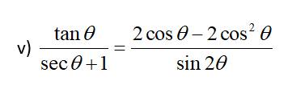
The right side looks a bit more messy, so let’s simplify the right side
Restrictions:

Slide 16

Another one of those where both sides are ugly….
So start with the left….
NOW begin with the right…..
Yeah… you should add these to your formula sheet…
YEP, pretty ugly….

Slide 17

NOW mess with the right…..

Slide 18
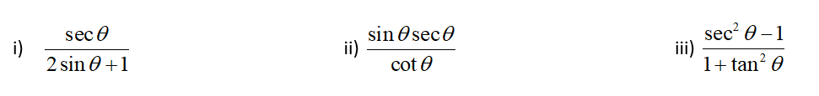

Slide 19
